Slide 1

Note: This slide deck is view-only.
Please don’t request edit access - it’s shared for your reference.
Make a copy of this slide for the project submission
On Campus

Slide 2

Guidelines
Kindly use the given template for submitting your project (Make a copy of the template)
One team is only required to submit one project/ppt.
The ideal size of the presentation should not be more than 10 slides.
You are welcome to add as many POCs and design concepts to support your project.
The project should be feasible and the team members should be capable enough, to come up with the prototype of the same idea, if required.
Solutions must include at least one Google technology.

Slide 3

Team Details
Team name: NOVA CORE
Team leader name: SOORYA GAYATHRY B R
Problem Statement: SMART AIR QUALITY ALERT WATCH-Instantly alerting people when the air they breathe becomes unsafe.

Slide 4
Problem Statement
Many people, especially those with breathing problems, elderly people, and children, go outside every day without knowing how polluted the air around them is. Sudden exposure to polluted air can cause breathing difficulty, discomfort, and even medical emergencies. Most existing solutions depend on smartphones, internet, or costly smart devices, which are difficult for rural people and elderly users to use in daily life.
Our Solution
We introduce a simple watch that looks and works like a normal watch but also protects health. Along with showing time, it quietly checks the air around the user. When the air becomes unsafe, the watch gently alerts the user using light and vibration, helping them take action at the right time. It does not need internet, mobile apps, or technical knowledge, making it affordable, easy to use, and suitable for everyone

Slide 5
How different from other ideas..?
Unlike existing air-pollution solutions such as mobile apps and smart watches that depend on smartphones, internet connectivity, and higher costs, our idea focuses on simplicity and accessibility. We designed a normal digital watch that not only shows time but also alerts users about unsafe air quality through light and vibration. It works automatically without apps or technical knowledge, making it especially suitable for patients, elderly people, children, and rural users who need a reliable and easy-to-use solution.
Advantages
Children: Helps parents know when air quality is unsafe for outdoor play
Elderly people: Reduces exposure to polluted air.
Asthma and heart patients: Provides early warnings to avoid health risks.
Daily commuters: Helps plan travel during safer air conditions.
People in industrial or traffic areas: Offers continuous protection

Slide 6
Features of the Smart Air Quality Alert Watch
Real-time Air Quality Monitoring : Continuously measures air quality around the user.
AQI Display : Shows current Air Quality Index in simple, easy-to-understand form.
Pollution Level Detection : Detects PM2.5, PM10, and harmful gases like CO and NO₂.
Instant Alert System : Vibrations, sound, or visual alerts when air becomes unsafe.
Color-Coded Air Status : Green (Good), Yellow (Moderate), Red (Dangerous) for quick understanding.
Portable & Wearable Design : Lightweight watch for continuous personal monitoring.
Location-Based Awareness : Reflects pollution changes based on user’s surroundings.
Low Power Consumption : Efficient battery usage for daily wear.
User-Friendly Interface : Simple display, easy for all age groups.
Health Safety Focused : Helps users avoid exposure and take timely precautions.
Scalable Design : Can be expanded with mobile apps and smart city systems.
Future-Ready Features : Support for GPS tracking, AI prediction, and mobile notifications.

Slide 7
Google Technologies Used
Google Cloud IoT Core – Acts as a bridge between your air sensor and Google Cloud.
Google Cloud Platform (GCP) - Cloud backend for large-scale sensor networks.
Google Firebase - Fast real-time database for sensor readings.
Google BigQuery - Big data analysis for sensor networks.

Slide 8
Process flow diagram
Start
↓
Air Quality Sensors
(PM2.5, PM10, Gas, Temp)
↓
Microcontroller(ESP32 / Arduino)
↓
AQI Calculation
↓
Is Pollution Level Safe?
↓ Yes ↓ No
Display Normal Status Trigger Alert
(Green / Yellow) (Vibration / Sound / Red)
↓ ↓
Send Data to Cloud (Firebase)
↓
Mobile App / Dashboard
↓
End

Slide 9
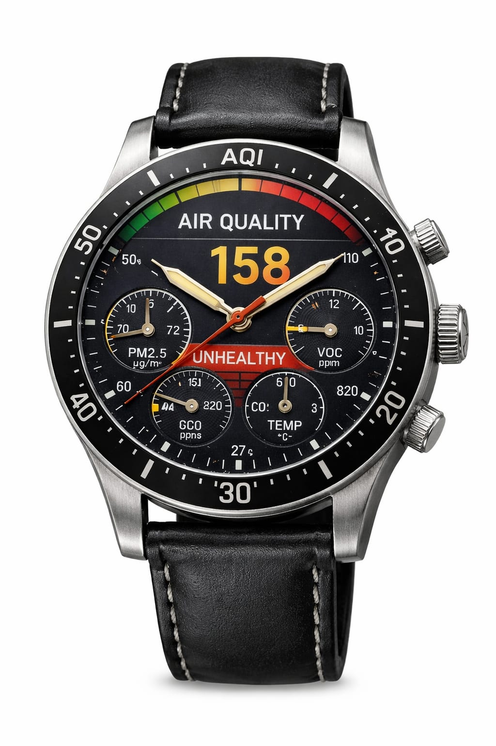
Air Quality
Sensors
(PM2.5,PM10,Gas,Temp,Humidity)
Microcontroller
(ESP32 / Arduino)
Data Processing
AQI Calculation
Alert Module
(Vibration / LED /Buzzer Display)
Mobile / Web App
- Live AQI View
- Notifications
- History Data
Cloud Platform
(Google Firebase / Google Cloud)

Slide 10
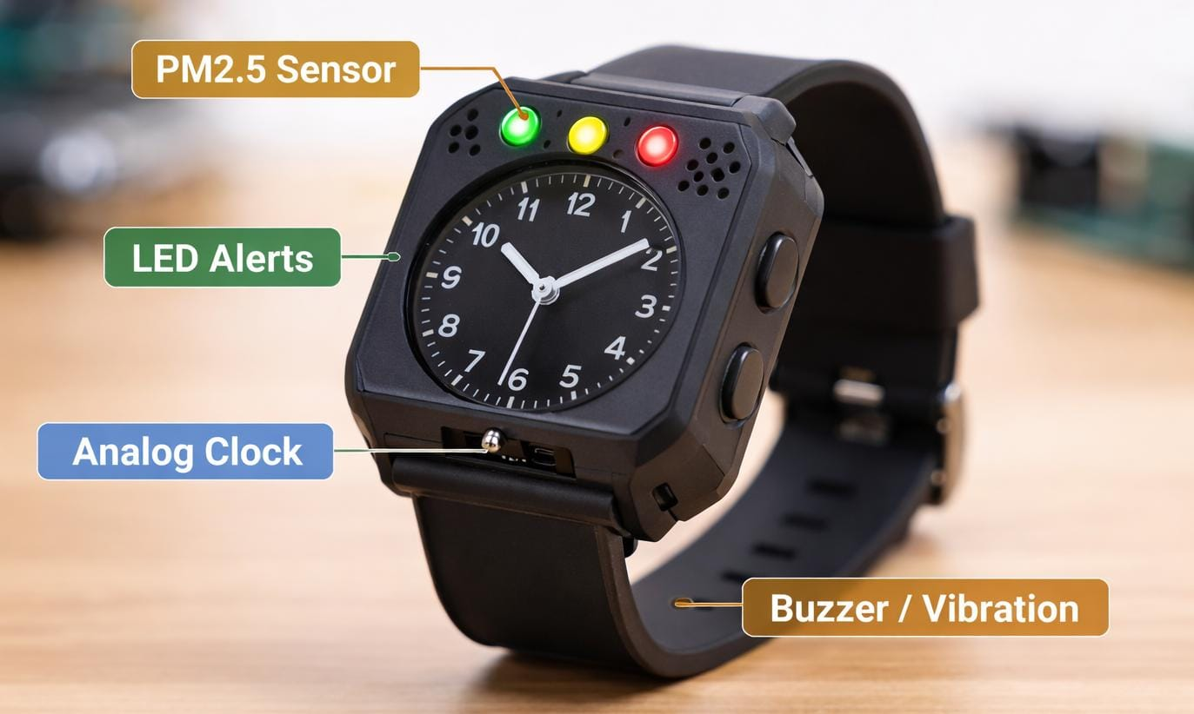
Snapshots of the MVP

Slide 11
Provide links to your:
GitHub Public Repository
Demo Video Link (3 Minutes)
MVP Link

Slide 12

Thank you!

